Slide 1




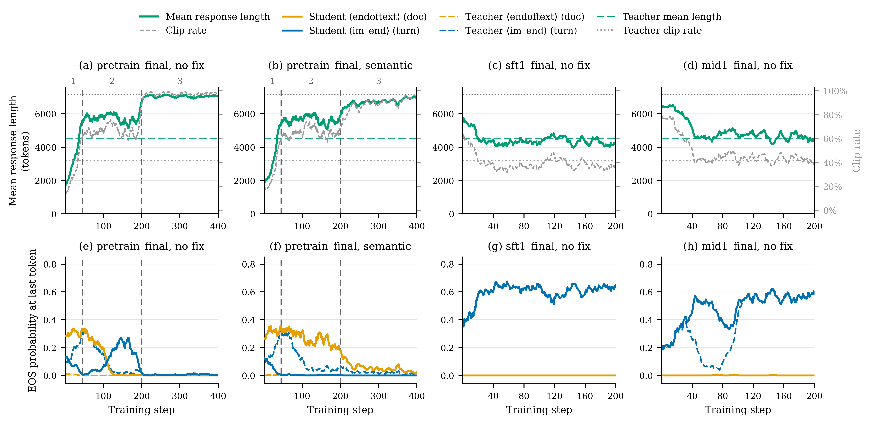
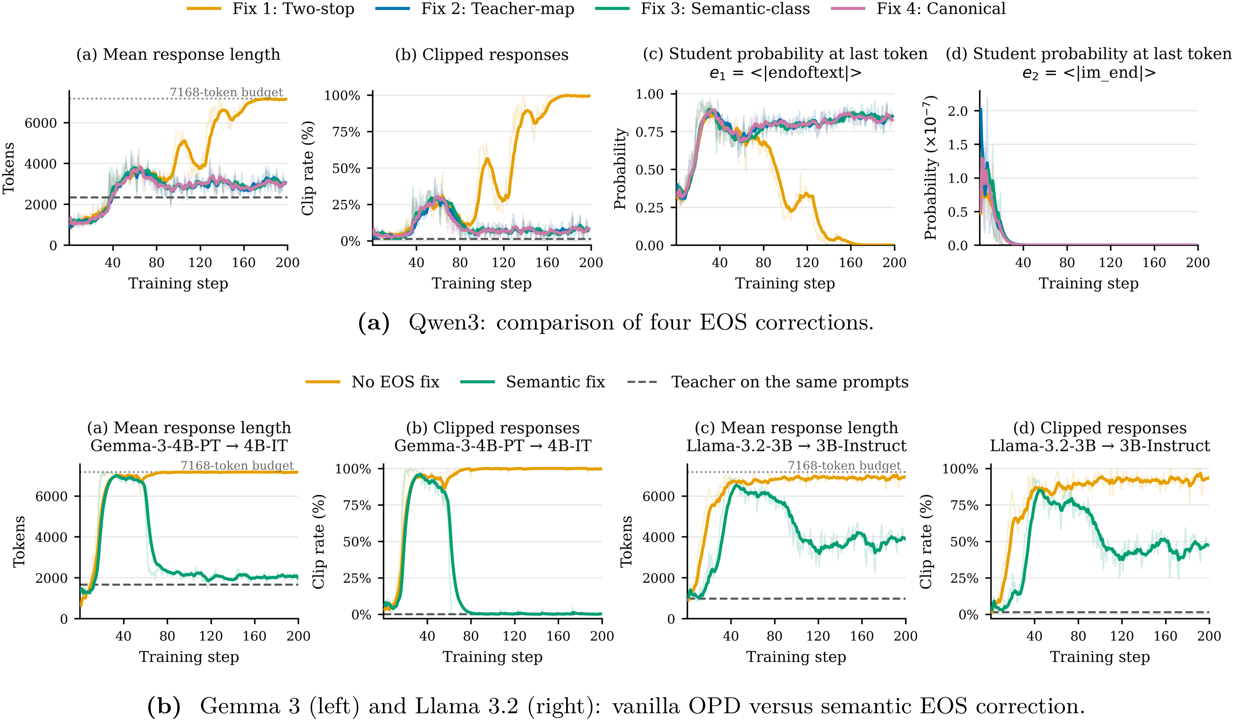

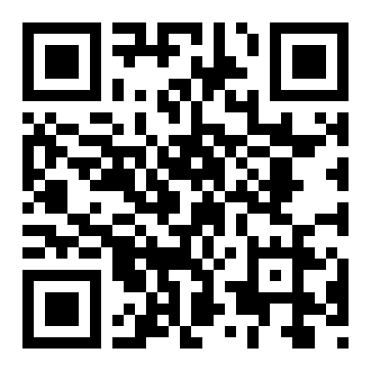
When EOS Tokens Disagree:
Understanding Length Inflation in On-Policy Distillation
Yuxiao Yang^{1*}, Tianrun Yu^{2*}, Shangzhe Li^{1*}, Kaixiang Zhao^{2*}, Xuchao Zhang³, Chetan Bansal³, Huaxiu Yao¹, Taylor W. Killian^{2†}, Weitong Zhang^{1‡}
¹ University of North Carolina at Chapel Hill ² Brigham Young University ³ Microsoft
Problem
Method
Key Results
Headline Numbers
Longer responses can mean a
failure to stop—not deeper
reasoning.
1
Group protocol-equivalent EOS tokens into
one semantic stop action.
Correcting the supervision—not just
decoding—restores stopping behavior.
94.4%
86.6%
Answer
repetition
On-policy distillation can suppress a
student’s stopping behavior.
Repetitive continuations exhaust the
generation budget even after the
student has already produced the
correct answer.
2
Sum their probabilities for both teacher
and student.
Semantic EOS aggregation substantially
reduces length and clipping across Qwen3,
Llama 3.2, and Gemma 3. Qwen3 and
Gemma approach teacher reference lengths
more closely; Llama retains a larger gap.
Redundant
tokens in one
failure
90.7%
Correction
loop
Illustrative example—not
average savings
3
Distill the semantic distribution; register all
equivalent tokens as valid rollout stops.
Takeaway
What the Fix Does
Not Solve
ALIGN
Motivation
Equivalent EOS tokens share stopping probability.
Non-EOS actions are unchanged.
The meaning of stopping, not just the EOS list.
STUDENT
≠
TEACHER
Semantic EOS aggregation fixes an
important, diagnosable cause of length
inflation—not every late-stage
collapse, and not necessarily
reasoning accuracy.
Stops with one
EOS token.
Prefers
another EOS
token.
Which Fix Works?
Correct the signal, not just decoding.
Scoring only the sampled surface
token can punish a valid stopping
action instead of transferring the
teacher’s termination behavior.
Group only operationally equivalent
tokens. Evidence here covers single-
turn mathematics.
Fig. 7 · Pretrain-to-final OPD re-inflates late, even
after semantic EOS alignment.
For Qwen3, the teacher-preferred
token has student probability of only
about 10⁻¹¹ near terminal states.
Adding it to the stop list barely helps
when it is almost never sampled.
Termination mismatch is important, but not
exhaustive.
K2-Horizon’s midtraining and SFT
initializations better match the final teacher.
The pretrained student still develops a distinct
late-stage stopping collapse.
Scan to
Read
Project
uncsciml.github.io/
opd-eos-website
Fig. 4 · Signal corrections work; decoder-only
alignment fails.
Paper
Code

